Slide 1

Medical embryology
Basrah university/ college of medicine
Department of human anatomy
DR. SAMER AlNUSSAIRI

Slide 2
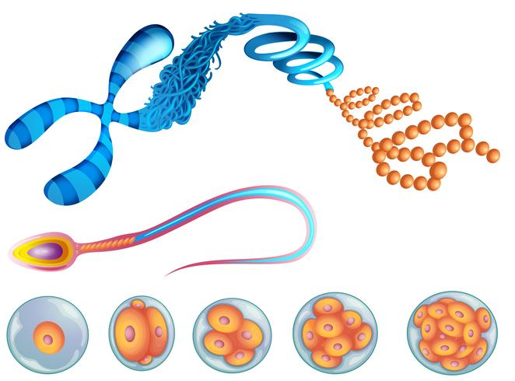
Objective
what is Mitosis and it’s stages?
What is Meiosis?
Features of first meiotic division?
Purpose of two meiotic divisions?
Non-disjunction.

Slide 3
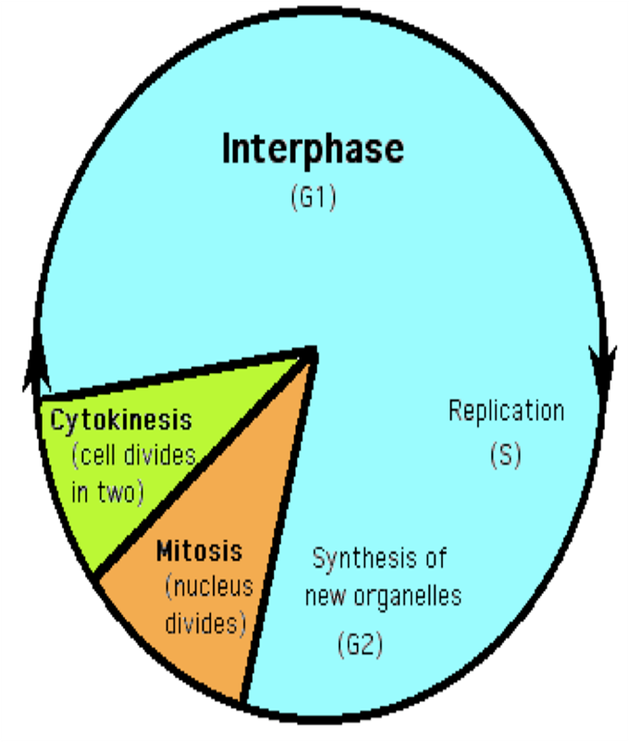
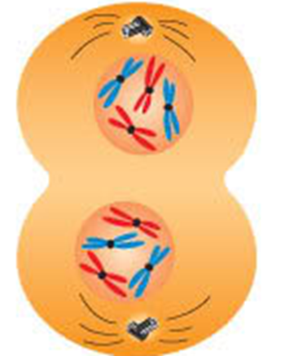
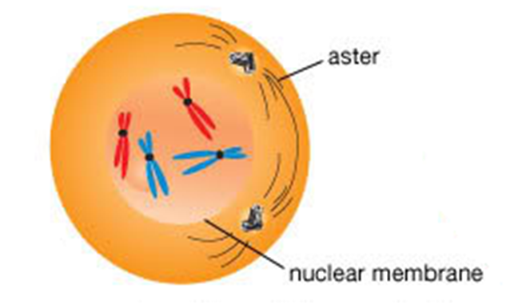
Mitosis
Cell cycle involves
1. Interphase: before division
2. Mitosis involves division of the chromosomes.
3. Cytokinesis: involves division of the cytoplasm.

Slide 4
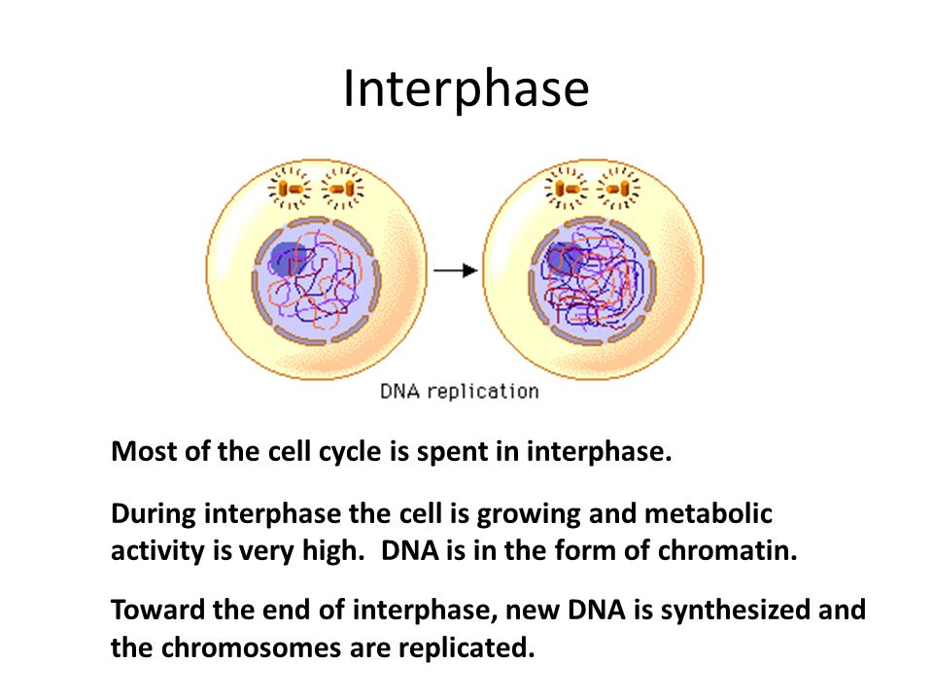
Interphase
- The cell is engaged in metabolic activity and performing its prepare for mitosis (the next four phases that lead up to and include nuclear division).
- DNA in a form of chromatin
- At the end of interphase : Chromosomes are replicated and new DNA is synthesized.

Slide 5
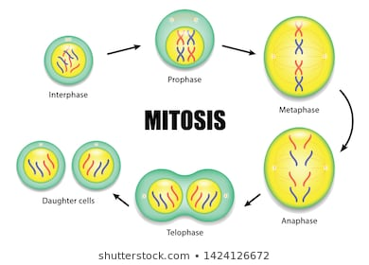
Mitosis
Mitosis is nuclear division plus cytokinesis, and produces two identical
daughter cells during the following steps:
  - Prophase.
  - Metaphase.
  - Anaphase.
  - Telophase.

Slide 6
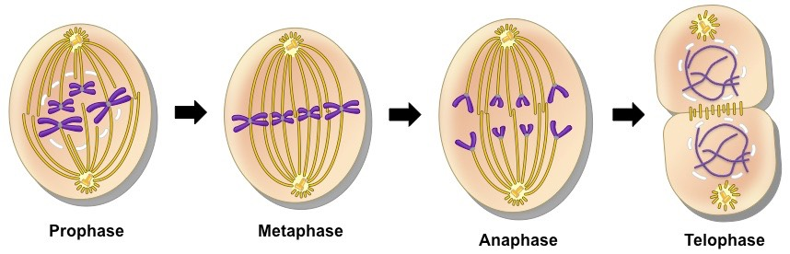
Phases Of Mitoses
4 phases of nuclear division (mitosis), directed by the cell’s DNA after DNA has been replicated.

Slide 7
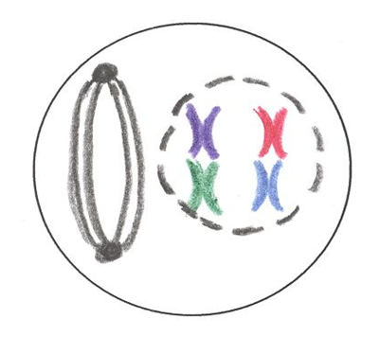
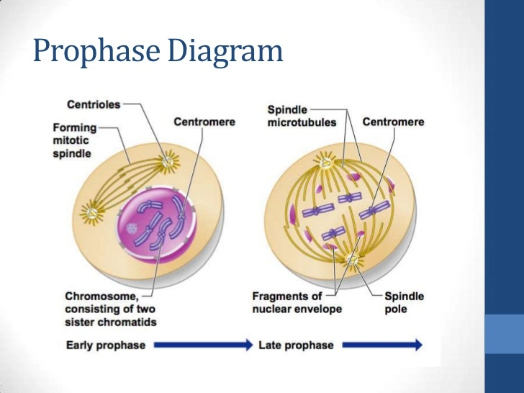
◆ Prophase
Nucleolus disappear
Chromatin condenses
Separation of centromere
Formation of mitotic spindle

Slide 8
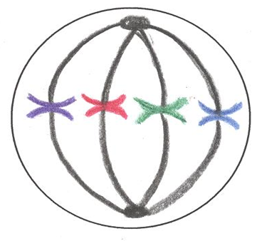
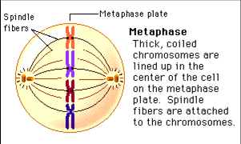
❖ Metaphase ( Middle )
The centriole and the mitotic spindle fibers move to opposite sides of the cell.
The nuclear membrane disintegrates.
.Chromosomes are aligned at the center of the cell.
The double stranded condensed chromosomes become visible.

Slide 9
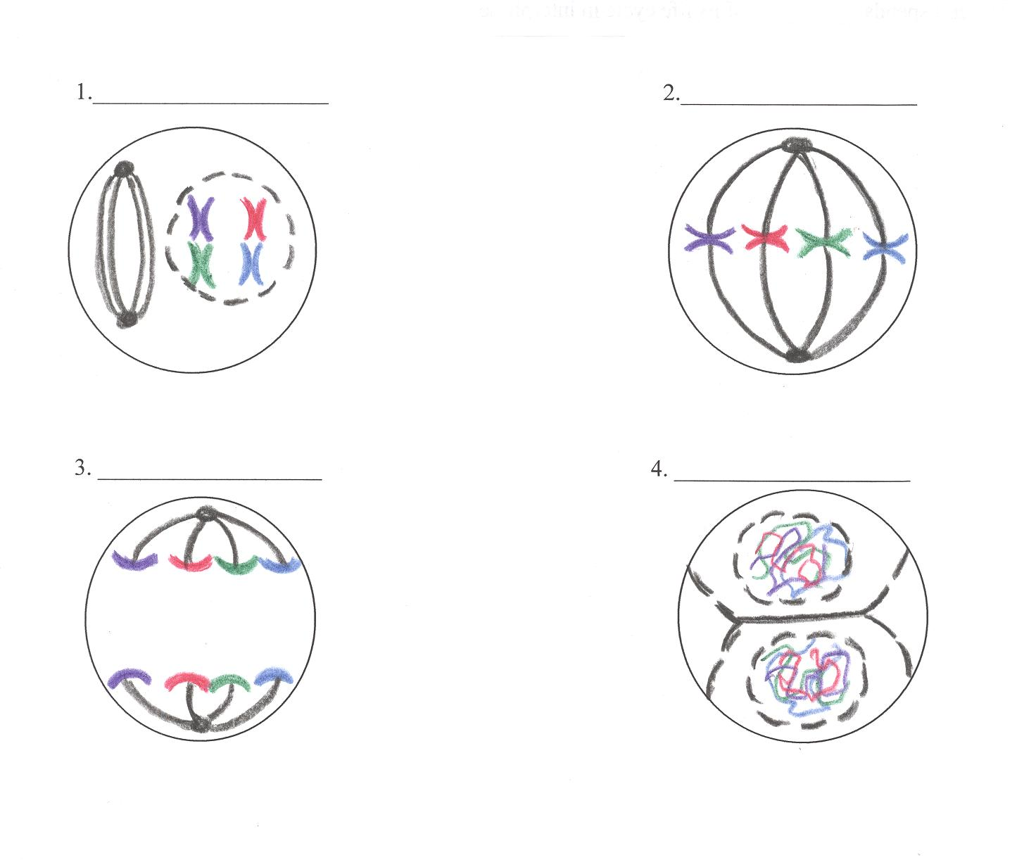
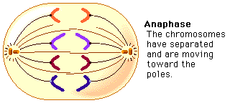
⬥ Anaphase
The spindle fibers pull the chromatids apart.
2. Chromosomes split apart
The chromatids move to
opposite ends of the cell.
3. Each chromatid is now a single
stranded chromosome containing
all of the necessary genetic
information.

Slide 10
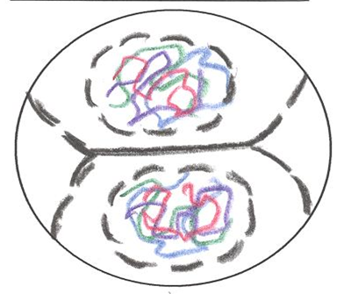
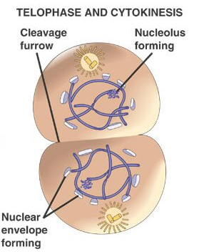
 Telophase
Nuclear envelope reforms around the chromosomes and uncoil.
Cytoplasm divides to form two daughter cells.
last phase splits the cell into two cells called daughter cells.
Cytokinesis
- Cyto=Cytoplasm
- Kinesis=Split
.
…

Slide 11
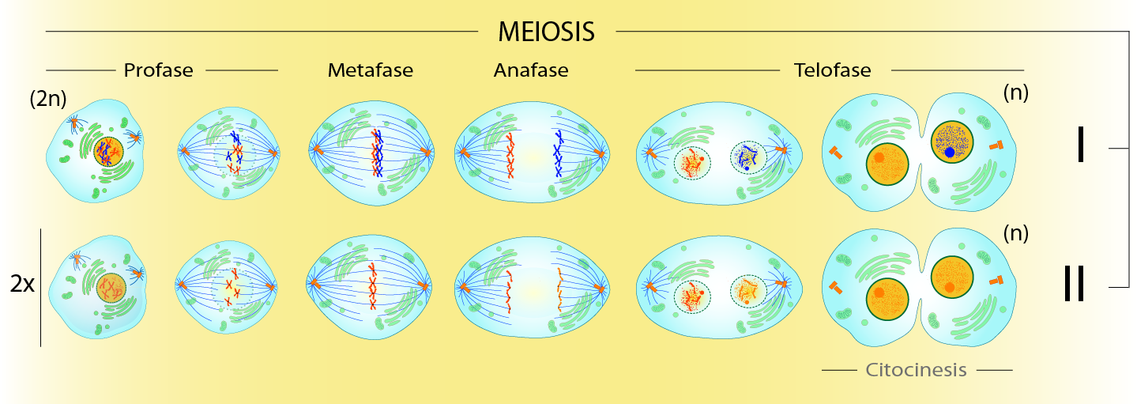
Meiosis
Diploid cells undergo meiosis to form haploid cells.
Meiosis I (Reduction)
reduces the diploidy level from 2n to n (reduction)
 Meiosis II divides the remaining set of chromosomes in a mitosis-like process (division).

Slide 12
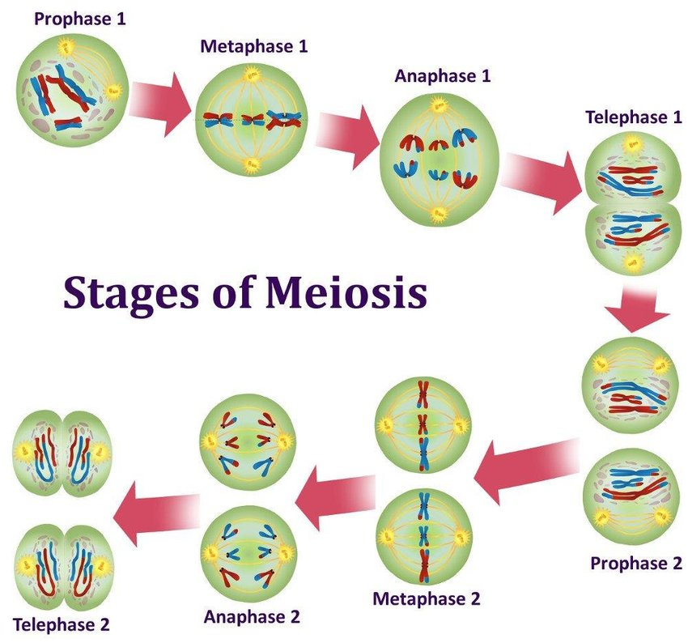
Meiosis
The end result is the production of cells containing half the amount of chromosomes (23).
During this process there is an exchange of genetic material therefore the daughter cells are not genetically identical.

Slide 13
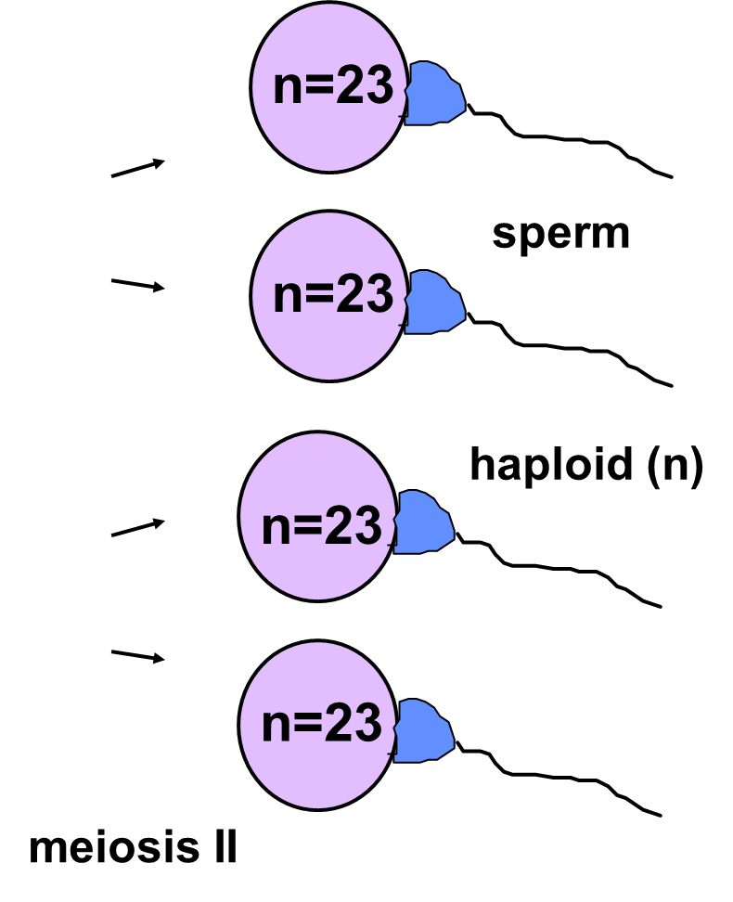
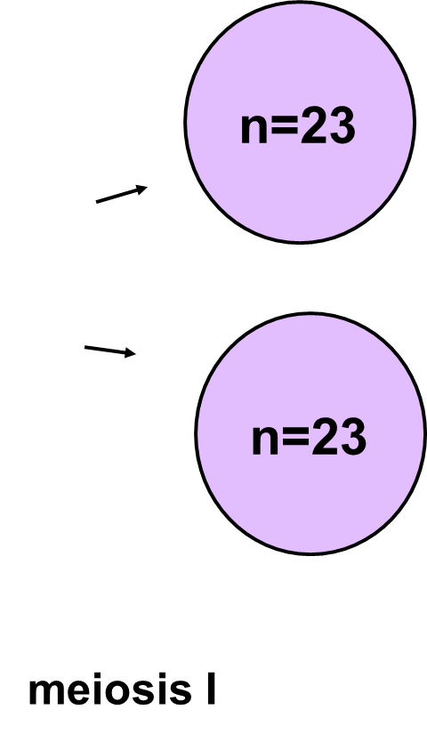
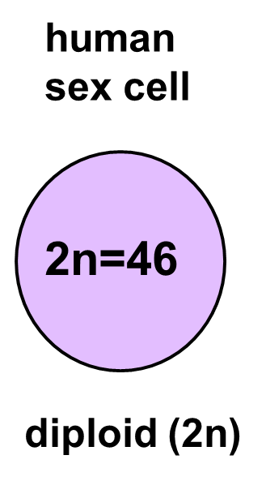
Sex cells divide to produce gametes (sperm or egg).
Gametes have half the of chromosomes.
Occurs only in gonads (testes or ovaries).

Slide 14
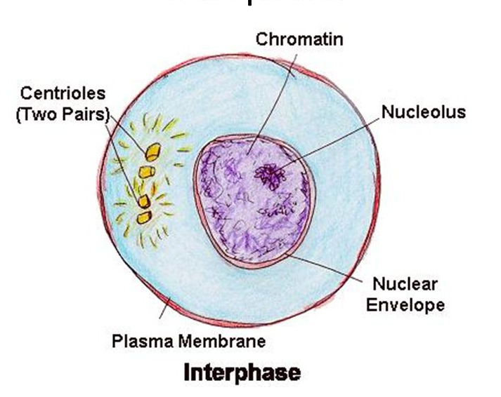
Meiosis: Interphase 1
Similar to mitosis interphase.
Chromosomes replicate
Each duplicated chromosome consist of two identical sister chromatids attached at their centromeres.
Centriole pairs also replicate.

Slide 15
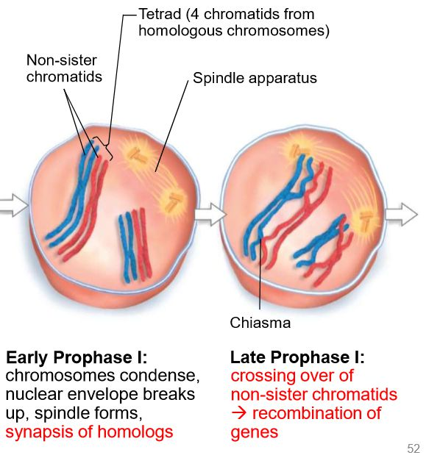
Meiosis1: Prophase 1
Chromosomes condense.
Synapsis occurs: homologous (Pair of chromosomes maternal and paternal that are similar in shape and size) chromosomes come together to form a tetrad.
Tetrad is two chromosomes or four chromatids.

Slide 16
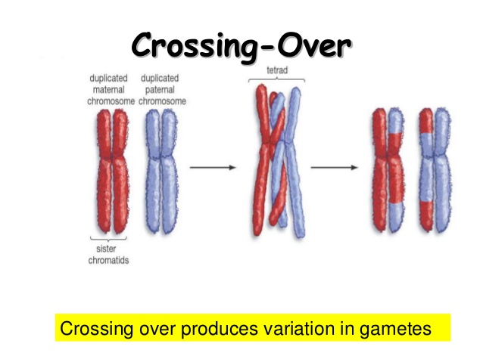
Crossing over
Crossing over (variation) may occur between non sister chromatids at the chiasmata.
Crossing over: segments of non sister chromatids break and reattach to the other chromatid.
Chiasmata (chiasma) are the sites of crossing over.

Slide 17
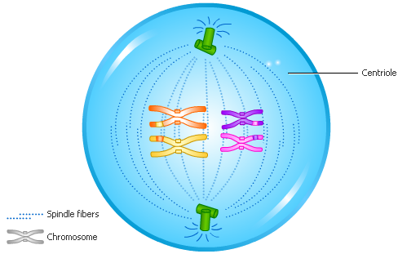
Metaphase 1
Shortest phase
Chromosomes attached to spindle fibers and align on metaphase plate in the middle

Slide 18
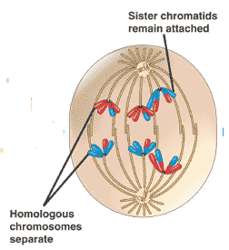
Anaphase1
Homologous chromosomes separate and move towards the poles.
Sister chromatids remain attached at their centromeres.

Slide 19
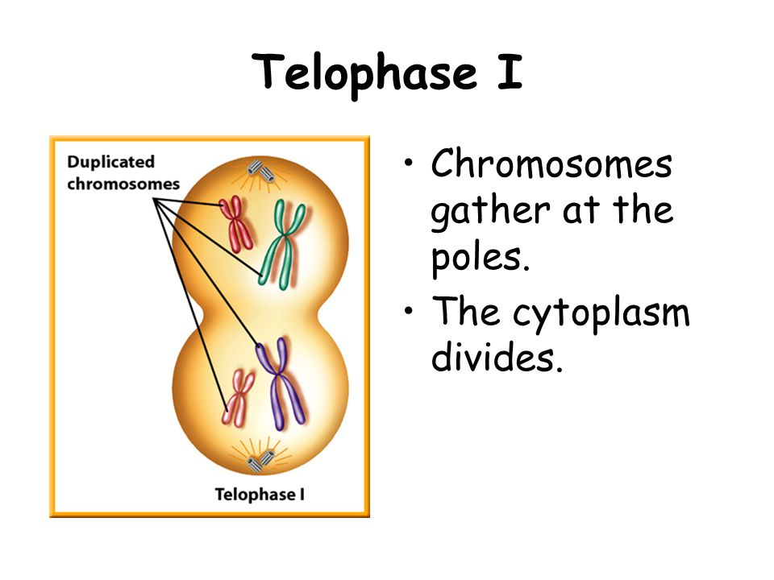
Telophase 1
Each pole now has haploid set of chromosomes.
Cytokinesis occurs and two haploid daughter cells are formed.

Slide 20
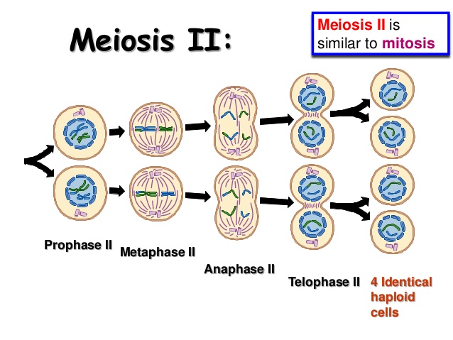
Meiosis II
Meiosis II is known as equational division, as the cells begin as haploid cells and end as haploid cells.
During the brief interphase period, no further DNA replication takes place.

Slide 21
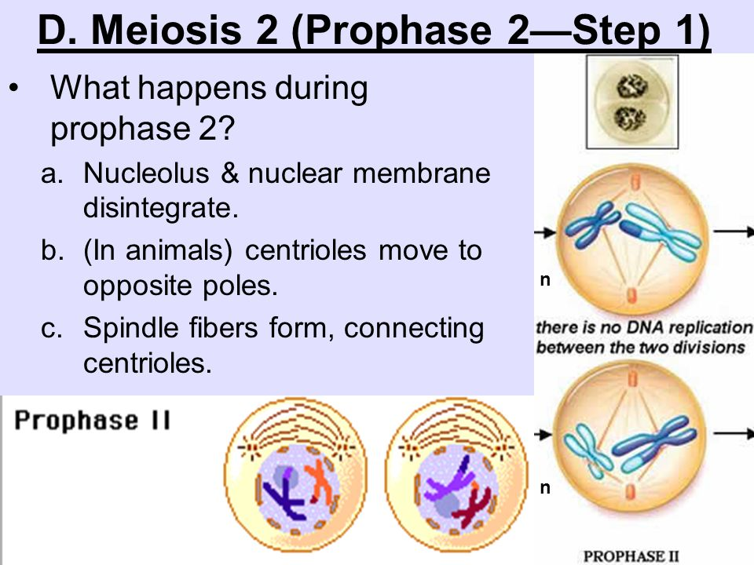
Prophase II

Slide 22
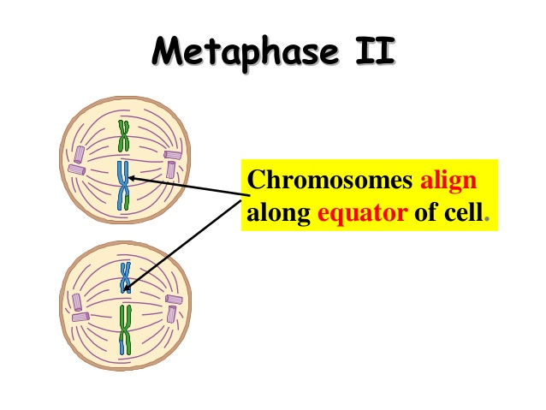
Metaphase II
Chromosomes align in the center of each cell at the equator same as mitosis.

Slide 23
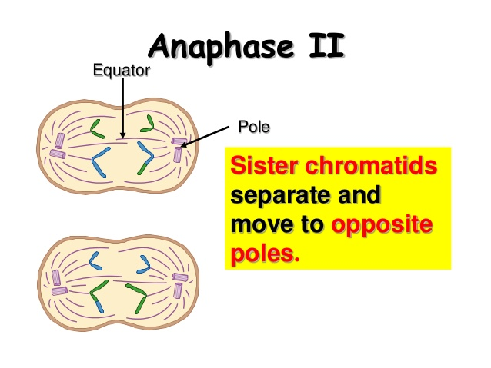
Anaphase II
- Sister chromatids separate.

Slide 24
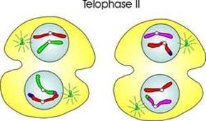
-The nuclear envelopes reappear and four haploid cells are the result.
Telophase II
.

Slide 25
Non disjunction
Nondisjunction can occur during anaphase of mitosis, meiosis I or meiosis II. During anaphase, sister chromatids (or homologous chromosomes) will separate and move to opposite poles of the cell, pulled by microtubules.
In nondisjunction, the separation fails to occur causing both sister chromatids or homologous chromosomes to be pulled to one pole of the cell.
.

Slide 26
Non disjunction
Mitotic nondisjunction can occur due to the inactivation of either topoisomerase II, condensin, or separase. This will result in 2 aneuploid* daughter cells, one with 47 chromosomes (2n+1) and the other with 45 chromosomes (2n-1).
* Aneuploid is the presence of an abnormal number of chromosomes in a cell e.g. (45 or 47) instead of the normal chromosomal number (46).

Slide 27
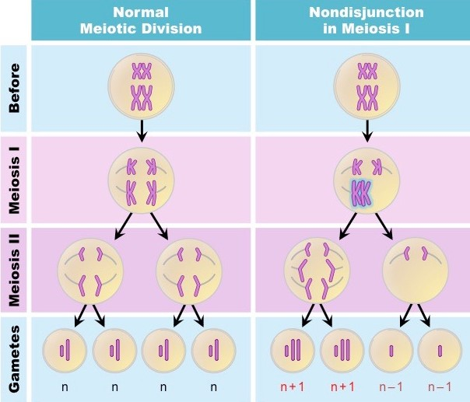
Non disjunction
- Nondisjunction in meiosis I occurs when the tetrads fail to separate during anaphase I. At the end of meiosis I, there will be 2 haploid daughter cells, one with n+1 and the other with n-1. Both of these daughter cells will then go on to divide once more in meiosis II, producing 4 daughter cells, 2 with n+1 and 2 with n-1.

Slide 28
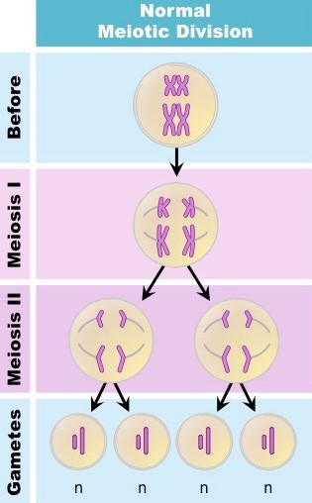
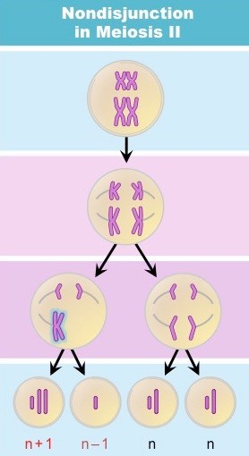
Non disjunction
- Nondisjunction in meiosis II results from the failure of the sister chromatids to separate during anaphase II. Since meiosis I proceeded without error, 2 of the 4 daughter cells will have a normal complement of 23 chromosomes. The other 2 daughter cells will be aneuploid, one with n+1 and the other with n-1.

Slide 29
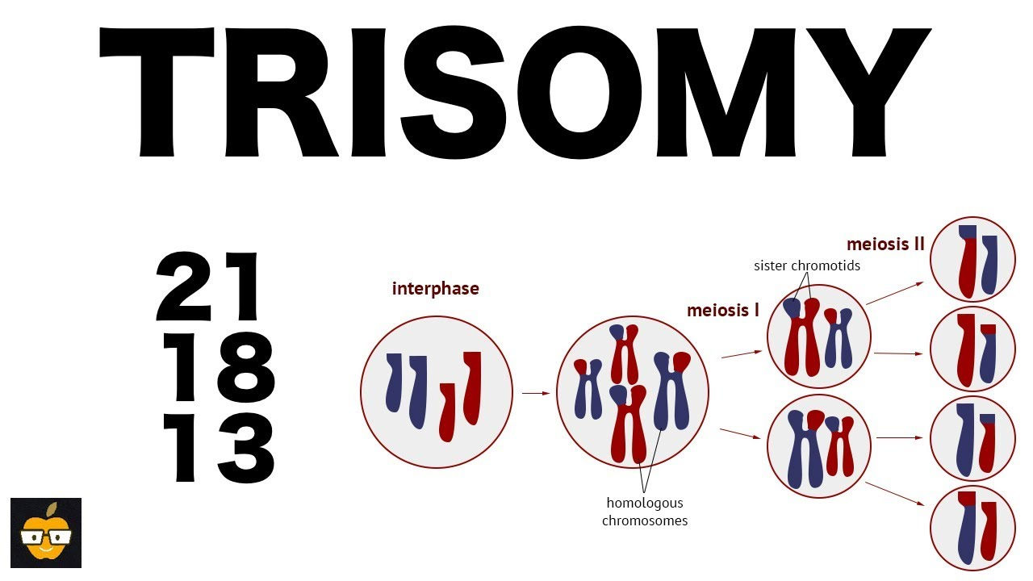
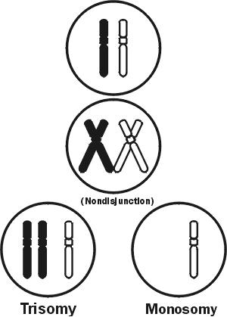
Non-disjunction disorders
- The three most common types of trisomy that are survivable are
Trisomy 21 (Down syndrome)
Trisomy 18 (Edwards syndrome)
Trisomy 13 (Patau syndrome).

Slide 30
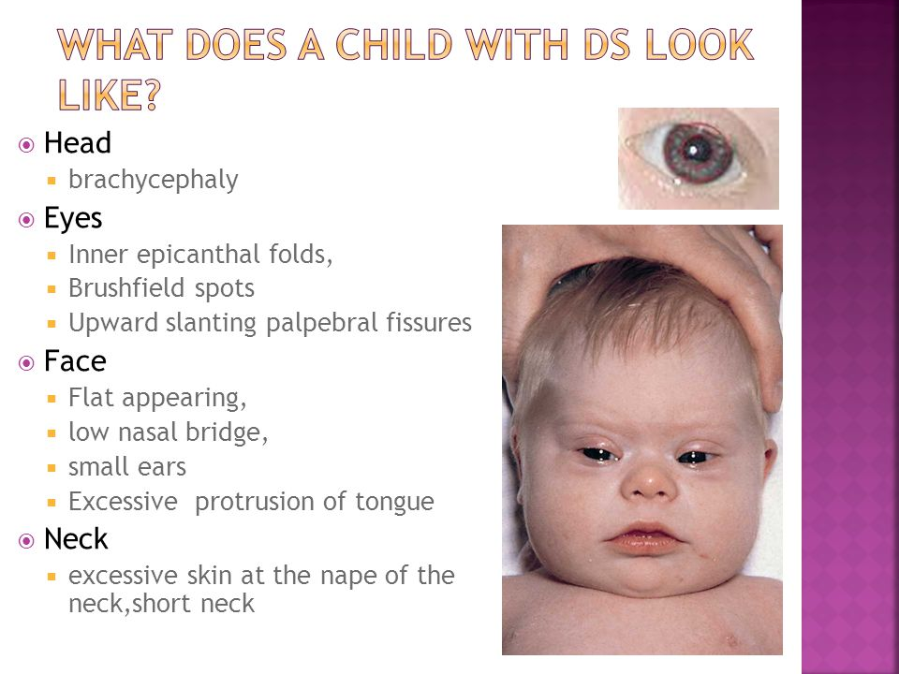
Trisomy 21 Down syndrome
The most common chromosomal disorder

Slide 31
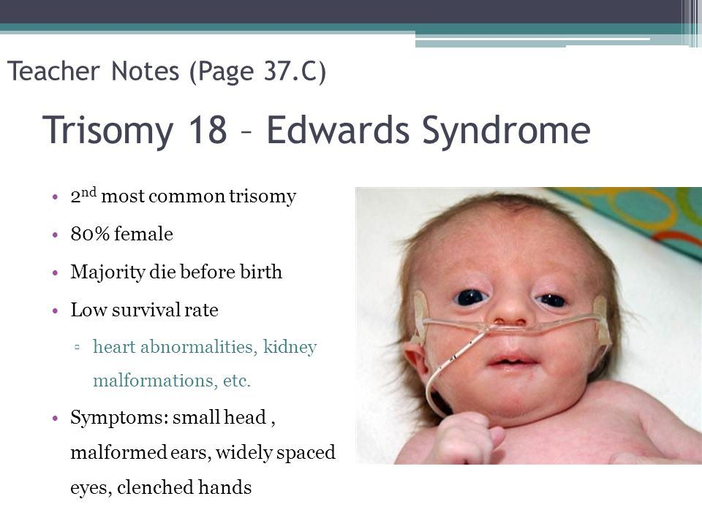

Slide 32
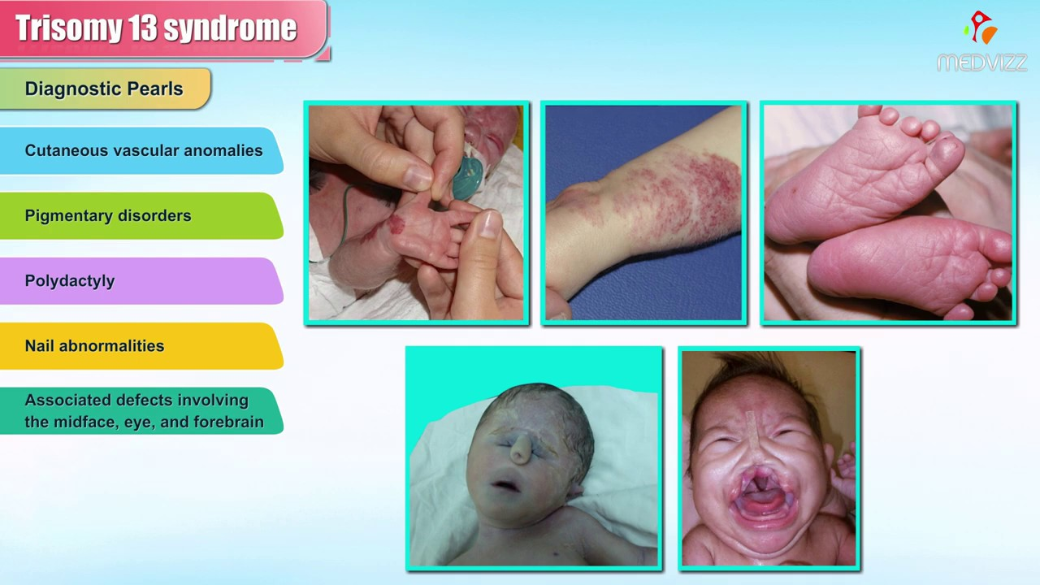

Slide 33


